Slide 1
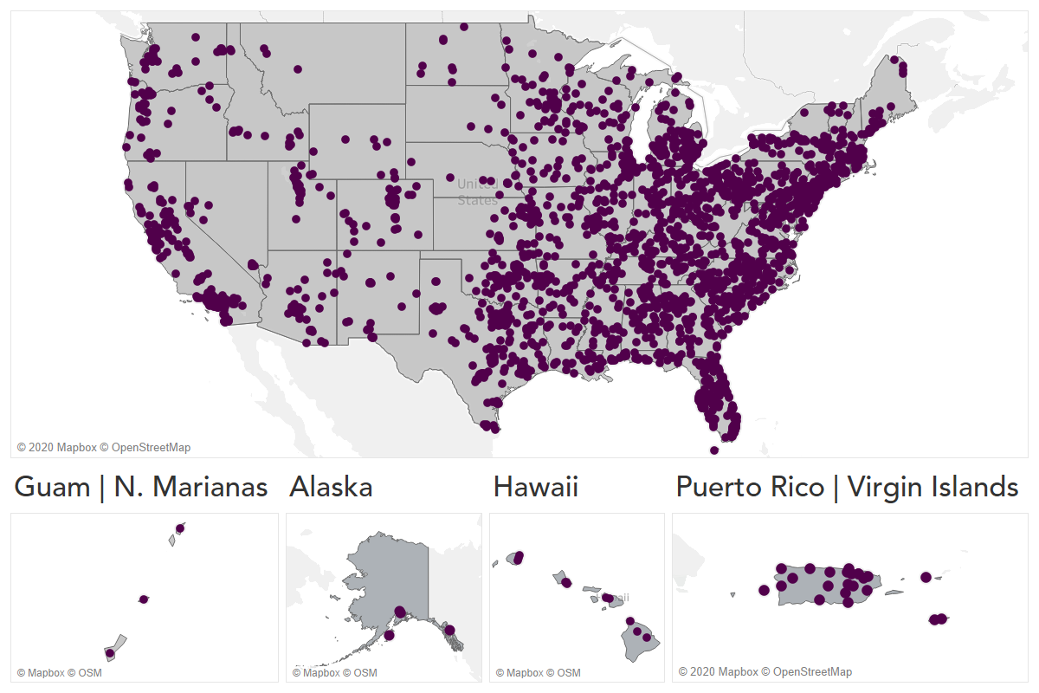
Strengthening Protections for Social Security Beneficiaries

Slide 2
About Representative Payees
Approximately 5.7 million payees managing $70 billion in annual benefits for 8 million beneficiaries.
Large Institutions (public and private)
Fee-for-Service Payees
Nursing Facilities / Assisted Living Facilities
Social Service Organizations
Individual Payees, including family members

Slide 3
Scope of P&A’s Rep Payee Review
Review Financial Records
Does the rep payee meet all of the beneficiary’s financial needs?
Clarify Rep Payee Responsibilities
Non-urgent referrals
Connect beneficiaries to community resources
Urgent Referrals
Recommend SSA contact rep payee to provide more training
Does the beneficiary have access to personal spending money?
Financial misuse
Health/Safety concerns
Provide information such as the “SSA Guide for Rep Payees”
Non-urgent referrals back to the P&As, i.e. Voting Registration, Restoration of Rights, Supported Decision-Making
Referral to P&A Monitoring Program

Slide 4
Rep Payee Reviews during COVID-19
Rep Payee Reviews are conducted over the phone, in-person, or combination of both
Outreach – P&As are creating resources, fact sheets, and surveys to providers
P&As are providing information, resources, and referrals regarding:
Enhanced safety measures,
Access to personal protective equipment, and
Economic impact payments

Slide 5
Impact of Rep Payee Reviews during COVID-19
Ensuring that congregate care facilities have access to PPE
Informing providers about COVID-19 testing locations and requirements
Preventing illegal evictions based on positive test results
Assisting provider with accessing supplemental funding and staffing resources

Slide 6
How do I contact my P&A’s rep payee program?
Click here to find your P&A.
Click here to learn how to recommend a payee for a rep payee review.

